Slide 1
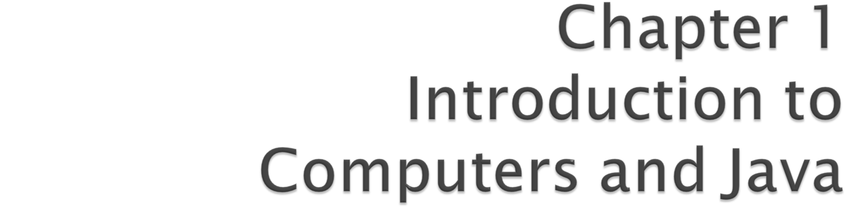
Java How to Program, 9/e
©1992-2012 by Pearson Education, Inc. All Rights Reserved.

Slide 2
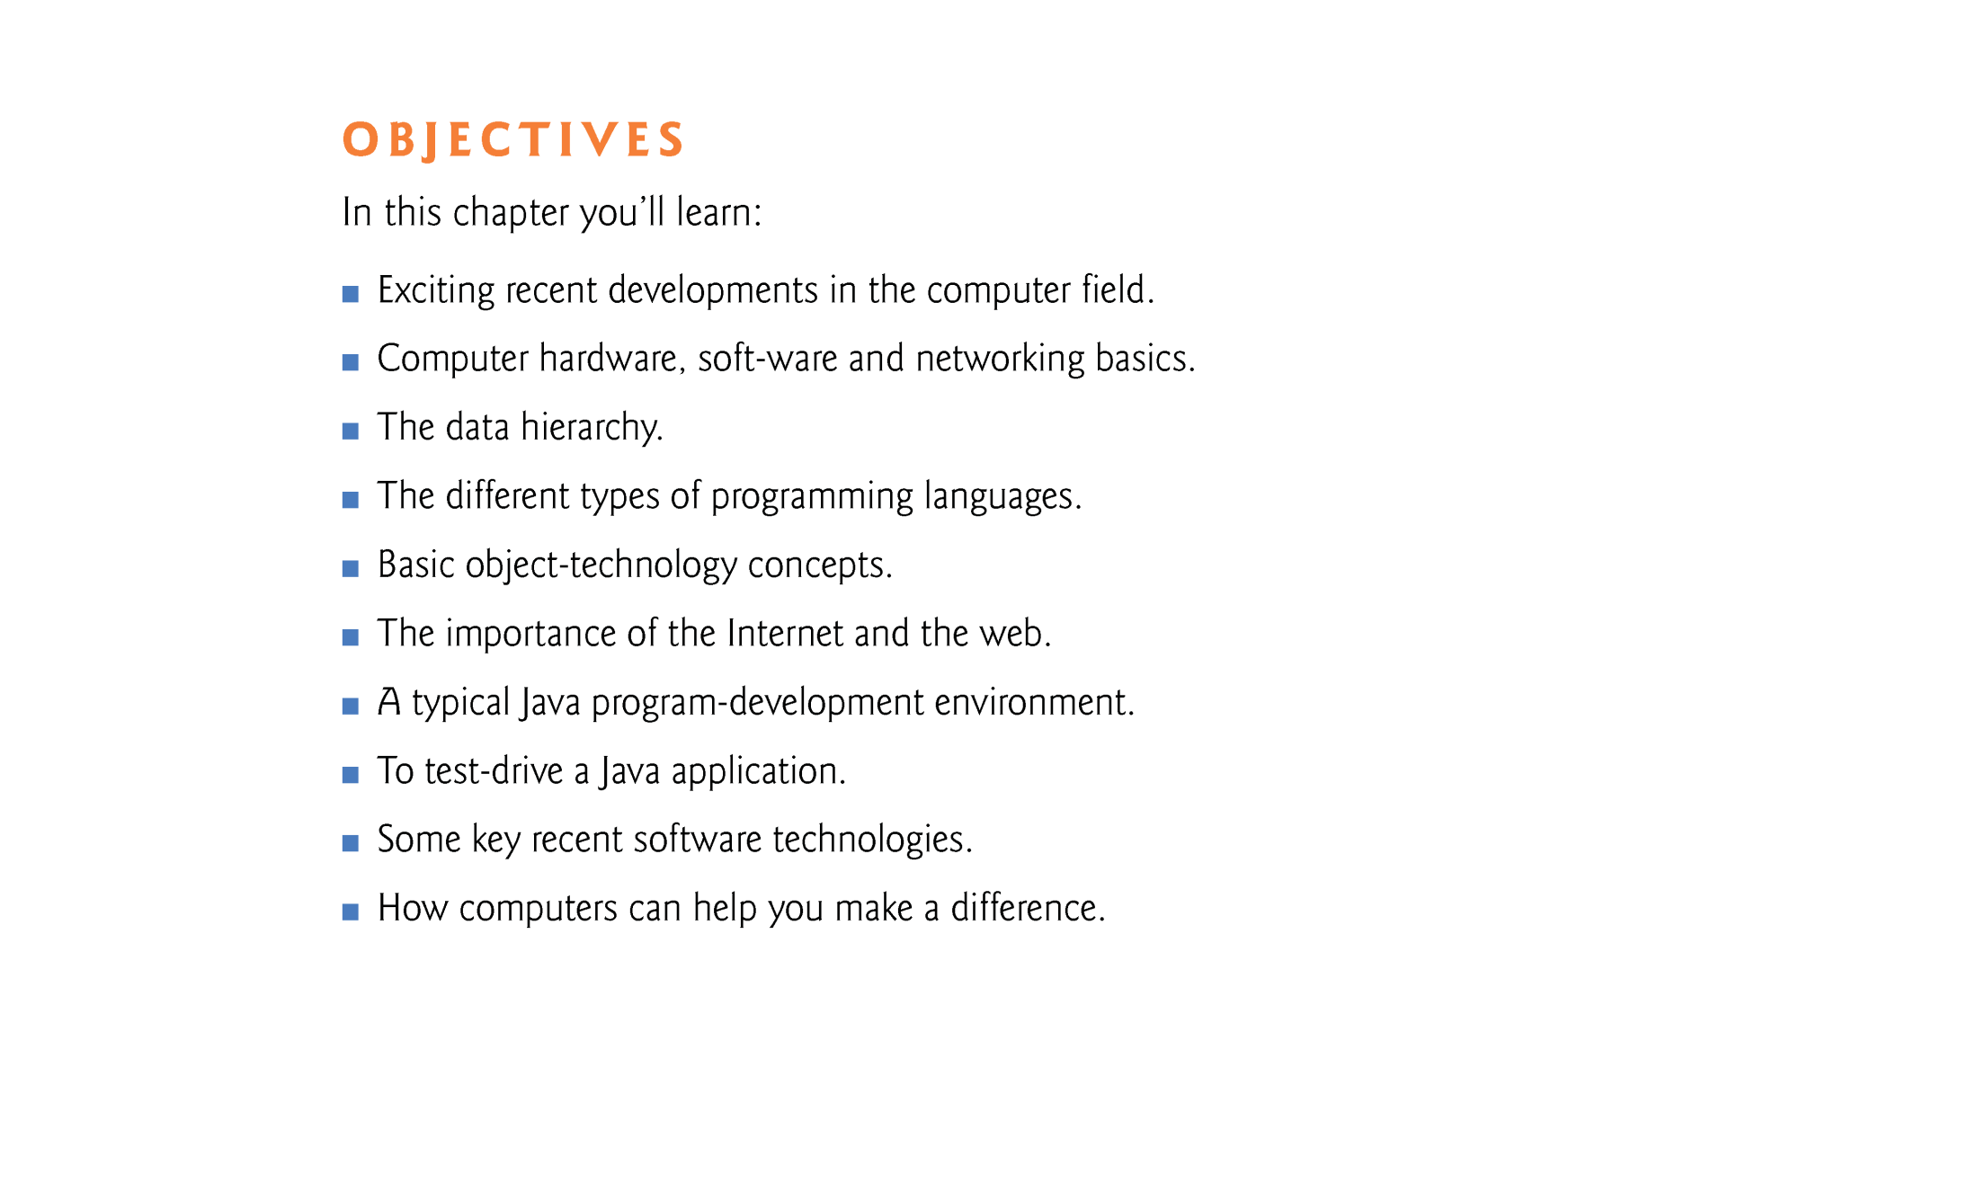
©1992-2012 by Pearson Education, Inc. All Rights Reserved.

Slide 3
©1992-2012 by Pearson Education, Inc. All Rights Reserved.

Slide 4
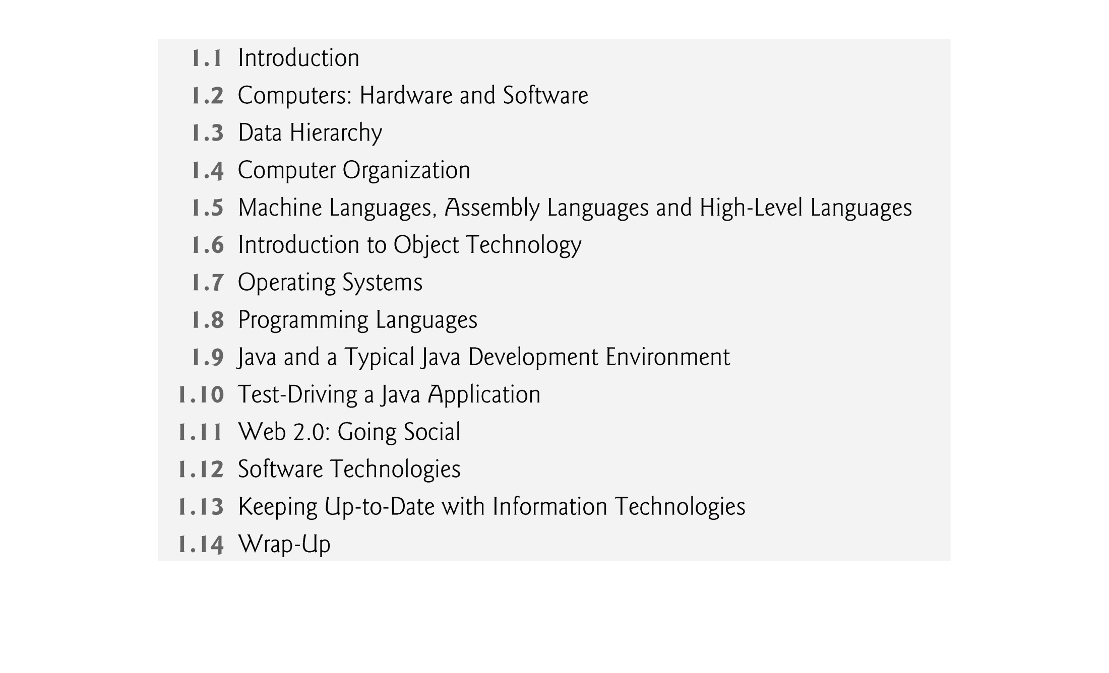
©1992-2012 by Pearson Education, Inc. All Rights Reserved.

Slide 5
©1992-2012 by Pearson Education, Inc. All Rights Reserved.

Slide 6
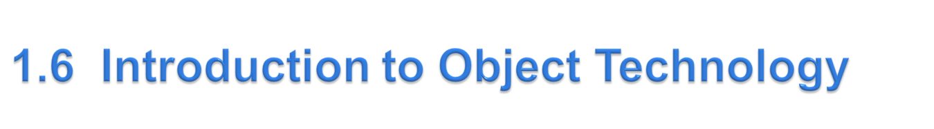
Objects, or more precisely, the classes objects, are essentially reusable software components.
  There are date objects, time objects, audio objects, video objects, automobile objects, people objects, etc.
  Almost any noun can be reasonably represented as a software object in terms of attributes (e.g., name, color and size) and behaviors (e.g., calculating, moving and communicating).
object-oriented programs are often easier to understand, correct and modify.
©1992-2012 by Pearson Education, Inc. All Rights Reserved.

Slide 7
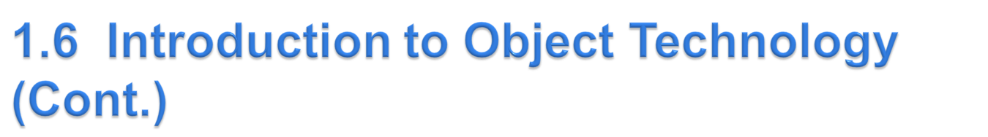
The Automobile as an Object
  Suppose you want to drive a car to make it go faster in some direction
  The automobile object interacts with other objects like pedal, brakes, gears etc. for driving
  Pedal hides from the driver the complex mechanisms that actually make the car go faster, just as the brake hides the mechanisms that slow the car, and the steering wheel “hides” the mechanisms that turn the car.
  Such information hiding is an important characteristic of OOP
  Enables people with little or no knowledge of how engines, braking and steering mechanisms work to drive a car easily.
©1992-2012 by Pearson Education, Inc. All Rights Reserved.

Slide 8
  Before you can drive a car, it must be built from the engineering drawings that describe it.
    Drawing – class
    Build – create an object
    Car – object
©1992-2012 by Pearson Education, Inc. All Rights Reserved.

Slide 9
  A completed car has an accelerator pedal to make the car go faster, but even that’s not enough—the car won’t accelerate on its own, so the driver must press the pedal to accelerate the car.
Methods and Classes
  Performing a task in a program requires a method.
  The method houses the program statements that actually perform its tasks.
  Hides these statements from its user, just as the accelerator pedal of a car hides from the driver the mechanisms of making the car go faster.
  In Java, we create a program unit called a class to house the set of methods that perform the class’s tasks.
  A class is similar in concept to a car’s engineering drawings, which house the design of an accelerator pedal, steering wheel, and so on.
©1992-2012 by Pearson Education, Inc. All Rights Reserved.

Slide 10
Instantiation
  Just as someone has to build a car from its engineering drawings before you can actually drive a car, you must build an object of a class before a program can perform the tasks that the class’s methods define.
  An object is then referred to as an instance of its class.
©1992-2012 by Pearson Education, Inc. All Rights Reserved.

Slide 11
Reuse
  Just as a car’s engineering drawings can be reused many times to build many cars, you can reuse a class many times to build many objects.
  Reuse of existing classes when building new classes and programs saves time and effort.
  Reuse also helps you build more reliable and effective systems, because existing classes and components often have gone through extensive testing, debugging and performance tuning.
  Just as the notion of interchangeable parts was crucial to the Industrial Revolution, reusable classes are crucial to the software revolution that has been made possible by object technology.
©1992-2012 by Pearson Education, Inc. All Rights Reserved.

Slide 12
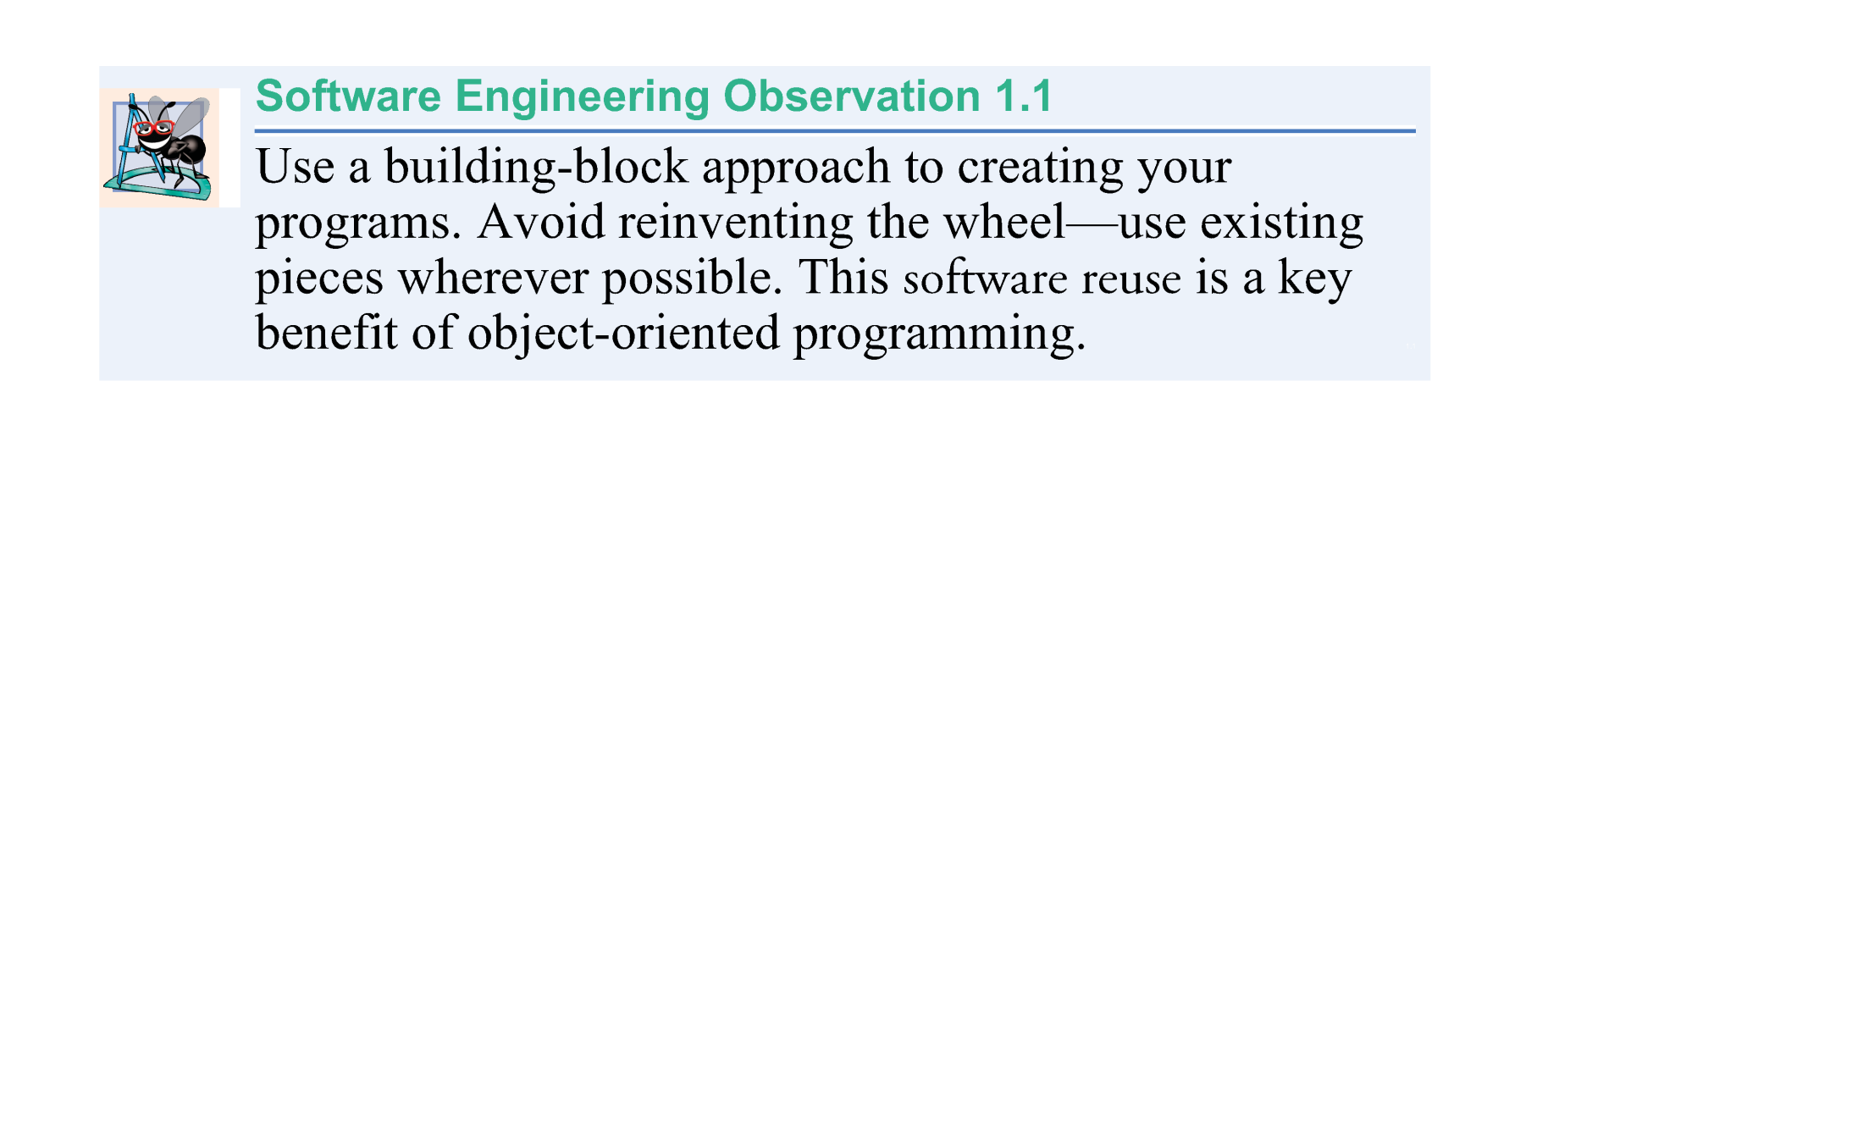
©1992-2012 by Pearson Education, Inc. All Rights Reserved.

Slide 13
Messages and Methods Calls
  When you drive a car, pressing its gas pedal sends a message to the car to perform a task—that is, to go faster.
  Similarly, you send messages to an object.
  Each message is implemented as a method call that tells a method of the object to perform its task.
©1992-2012 by Pearson Education, Inc. All Rights Reserved.

Slide 14
Attributes and Instance Variables
  A car has attributes
    Color, its number of doors, current amount of gas in its tank, its current speed, maximum speed and its record of total miles driven (i.e., its odometer reading).
  Every car has its own attributes.
  Each car knows how much gas is in its own gas tank, but not how much is in the tanks of other cars.
©1992-2012 by Pearson Education, Inc. All Rights Reserved.

Slide 15
Encapsulation
  Classes encapsulate (i.e., wrap) attributes and methods into objects—an object’s attributes and methods are intimately related. You have to swallow this capsule altogether (as a whole and not in isolation) to get something done.
  Objects may communicate with one another, but they’re normally not allowed to know how other objects are implemented—implementation details are hidden within the objects themselves.
  This Abstraction or Information hiding, as we’ll see, is crucial to good software engineering.
©1992-2012 by Pearson Education, Inc. All Rights Reserved.

Slide 16
Inheritance
  Perhaps the most important but simple concept in OOP
  A new class of objects can be created quickly and conveniently by inheritance—the new class absorbs the characteristics of an existing class, possibly customizing them and adding unique characteristics of its own.
  In our car analogy, an object of class “convertible” certainly is an object of the more general class “automobile,” but more specifically, the roof can be raised or lowered.
©1992-2012 by Pearson Education, Inc. All Rights Reserved.

Slide 17
Object-Oriented Analysis and Design (OOAD)
  How will you create the code (i.e., the program instructions) for your programs?
  Follow a detailed analysis process for determining your project’s requirements (i.e., defining what the system is supposed to do)
  Develop a design that satisfies them (i.e., deciding how the system should do it).
  Carefully review the design (and have your design reviewed by other software professionals) before writing any code.
©1992-2012 by Pearson Education, Inc. All Rights Reserved.

Slide 18
  Analyzing and designing your system from an object-oriented point of view is called an object-oriented analysis and design (OOAD) process.
  Languages like Java are object oriented.
  Object-oriented programming (OOP) allows you to implement an object-oriented design as a working system.
©1992-2012 by Pearson Education, Inc. All Rights Reserved.

Slide 19
The UML (Unified Modeling Language)
  The Unified Modeling Language (UML) is the most widely used graphical scheme for modeling object-oriented systems.
  More to come soon about UML
©1992-2012 by Pearson Education, Inc. All Rights Reserved.

Slide 20
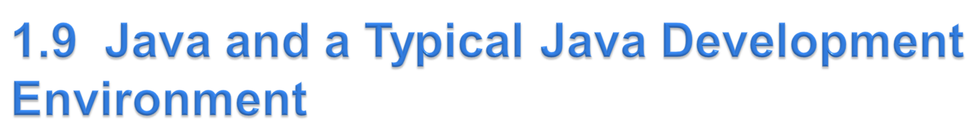
In 1991, Sun Microsystems developed a C++-based object-oriented programming language called JAVA.
  Key goal of Java is to be able to write programs that will run on a great variety of computer systems and computer-control devices – a characteristic of programs called portability
  This is sometimes also called “write once, run anywhere.”
©1992-2012 by Pearson Education, Inc. All Rights Reserved.

Slide 21
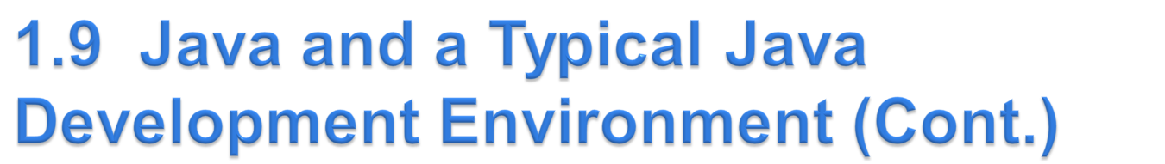
1993
  The web exploded in popularity
  Sun saw the potential of using Java to add dynamic content to web pages.
Java attracted the business community because of the phenomenal interest in the web.
Java is used to develop large-scale enterprise applications, to enhance the functionality of web servers, to provide applications for consumer devices and for many other purposes.
Java Applets are Java based applications running directly on web browsers supporting java compilation (out of scope of this course))
©1992-2012 by Pearson Education, Inc. All Rights Reserved.

Slide 22
Sun Microsystems was acquired by Oracle in 2009.
As of 2010 97% of enterprise desktops, three billion handsets, and 80 million television devices run Java.
Java is the most widely used software development language in the world.
©1992-2012 by Pearson Education, Inc. All Rights Reserved.

Slide 23
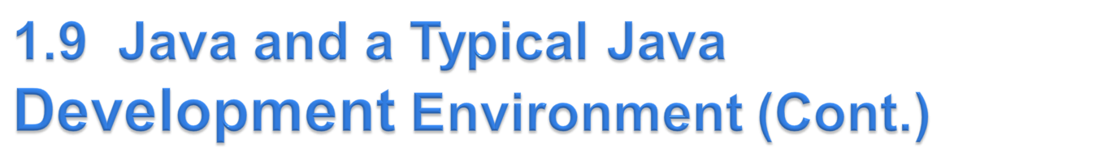
Java Class Libraries
  Rich collections of existing classes and methods
  Also known as the Java APIs (Application Programming Interfaces).
©1992-2012 by Pearson Education, Inc. All Rights Reserved.

Slide 24
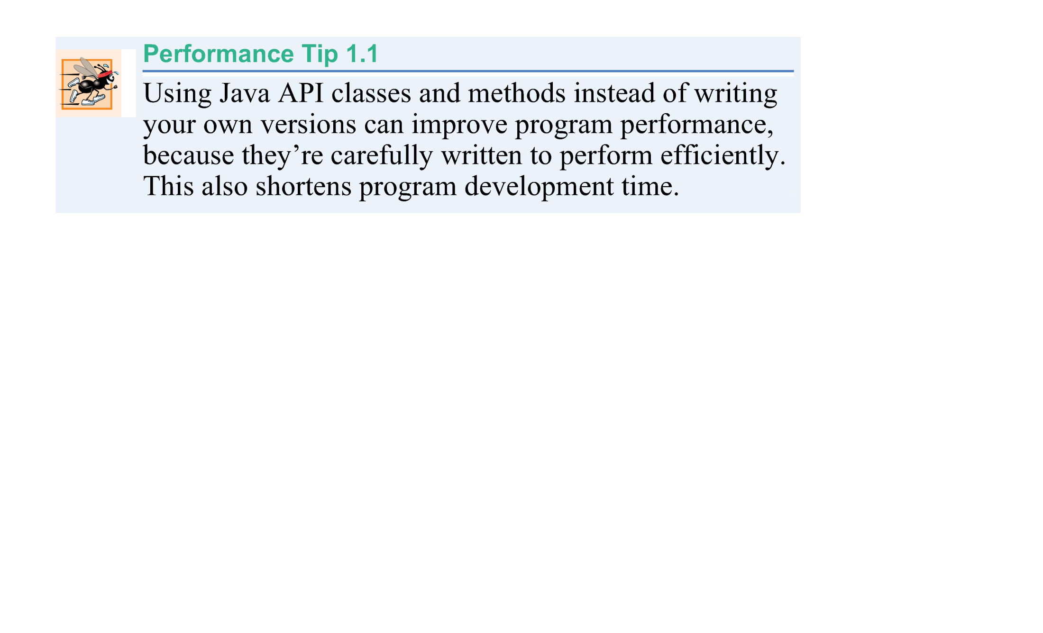
©1992-2012 by Pearson Education, Inc. All Rights Reserved.

Slide 25

Java Compiler
  JDK8 Java SE Development Kit for your version of window
An IDE
  Eclipse eclipse-jee-luna
  NetBeans IDE 8.0.2
Installation instructions
  Step 1: Install JDK before installing IDE
  Step 2: Choose the IDE of your choice
Follow the order in installing JDK and its IDE
Download the JDK and its documentation from
  www.oracle.com/technetwork/java/javase/downloads/index.html.
©1992-2012 by Pearson Education, Inc. All Rights Reserved.

Slide 26
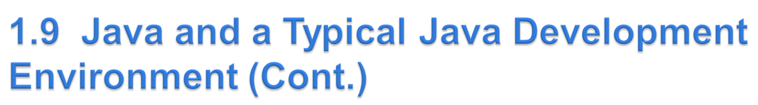
Java programs normally go through five phases
  edit
  compile
  load
  verify
  execute.
©1992-2012 by Pearson Education, Inc. All Rights Reserved.

Slide 27
Phase 1 consists of editing a file with an I
  Type a Java program (source code) using the editor.
  Make any necessary corrections.
  Save the program.
  A file name ending with the .java extension indicates that the file contains Java source code.
©1992-2012 by Pearson Education, Inc. All Rights Reserved.

Slide 28
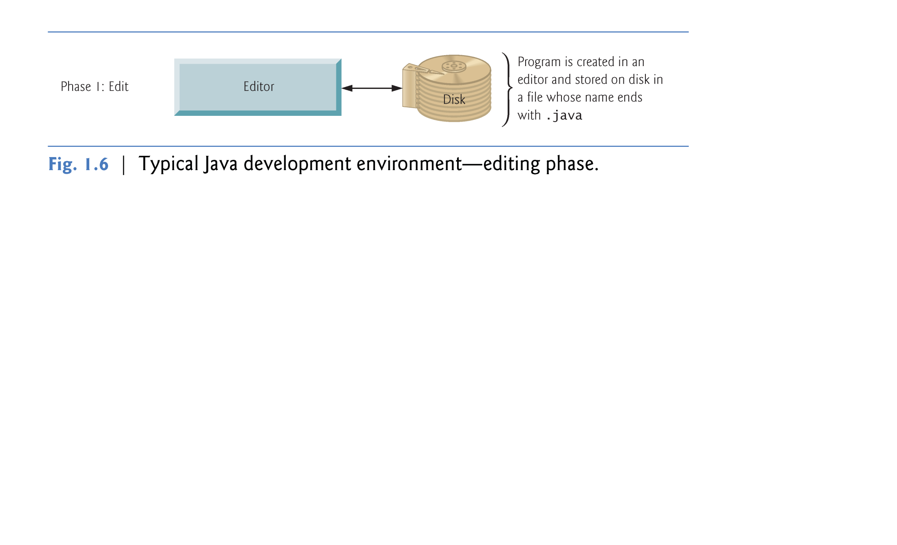
©1992-2012 by Pearson Education, Inc. All Rights Reserved.

Slide 29
Linux editors: vi and emacs.
Windows editors:
  Notepad
  EditPlus (www.editplus.com)
  TextPad (www.textpad.com)
  jEdit (www.jedit.org).
Integrated development environments (IDEs)
  Provide tools that support the software development process, including editors for writing and editing programs and debuggers for locating logic errors—errors that cause programs to execute incorrectly.
©1992-2012 by Pearson Education, Inc. All Rights Reserved.

Slide 30
Popular IDEs
  Eclipse (www.eclipse.org)
  NetBeans (www.netbeans.org).
  jGRASP™ IDE (www.jgrasp.org)
  DrJava IDE (www.drjava.org/download.shtml)
  BlueJ IDE (www.bluej.org/)
  TextPad® Text Editor for Windows® (www.textpad.com/)
©1992-2012 by Pearson Education, Inc. All Rights Reserved.

Slide 31
Phase 2: Compiling a Java Program into Bytecodes
  Bytecodes are intermediate code from source code to object (machine language) code
  Use the command javac (the Java compiler) to compile a program. For example, to compile a program called Welcome.java, you’d type
    javac Welcome.java
  If the program compiles, the compiler produces a .class file called Welcome.class that contains the compiled version of the program.
©1992-2012 by Pearson Education, Inc. All Rights Reserved.

Slide 32
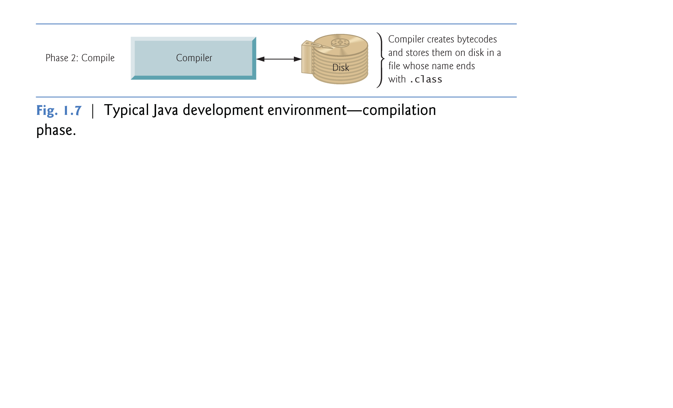
©1992-2012 by Pearson Education, Inc. All Rights Reserved.

Slide 33
Java compiler translates Java source code into bytecodes that represent the tasks to execute.
Bytecodes are executed by the Java Virtual Machine (JVM)—a part of the JDK and the foundation of the Java platform.
Virtual machine (VM)—a software application that simulates a computer
  Hides the underlying operating system and hardware from the programs that interact with it.
If the same VM is implemented on many computer platforms, applications that it executes can be used on all those platforms.
©1992-2012 by Pearson Education, Inc. All Rights Reserved.

Slide 34
Bytecodes are platform independent
  They do not depend on a particular hardware platform.
Bytecodes are portable
  The same bytecodes can execute on any platform containing a JVM that understands the version of Java in which the bytecodes were compiled.
The JVM is invoked by the java command. For example, to execute a Java application called Welcome, you’d type the command
    java Welcome
No .class should be used with the file name here
©1992-2012 by Pearson Education, Inc. All Rights Reserved.

Slide 35
Phase 3: Loading a Program into Memory
  The JVM places the program in memory to execute it—this is known as loading.
  Class loader takes the .class files containing the program’s bytecodes and transfers them to primary memory.
  Also loads any of the .class files provided by Java that your program uses.
The .class files can be loaded from a disk on your system or over a network.
©1992-2012 by Pearson Education, Inc. All Rights Reserved.

Slide 36
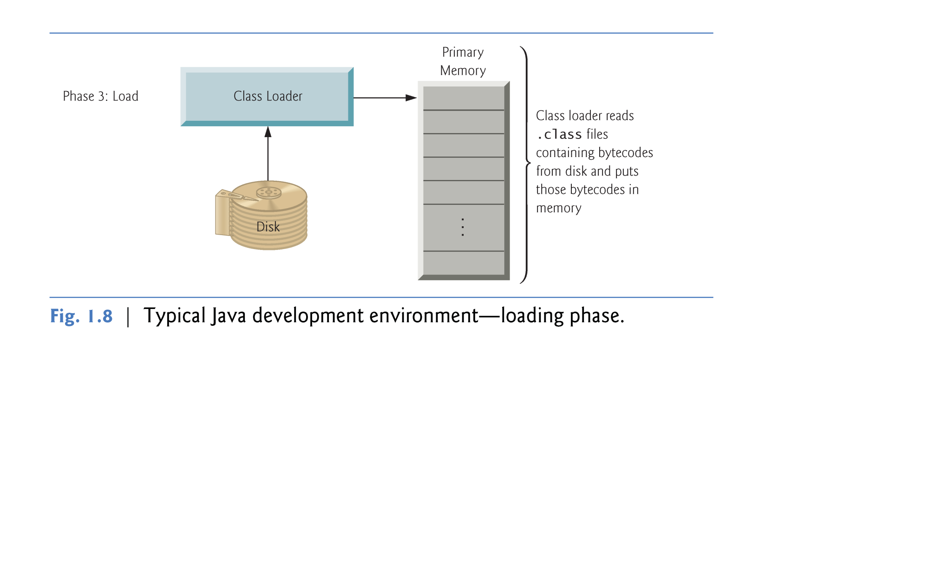
©1992-2012 by Pearson Education, Inc. All Rights Reserved.

Slide 37
Phase 4: Bytecode Verification
  As the classes are loaded, the bytecode verifier examines their bytecodes
  Ensures that they’re valid and do not violate Java’s security restrictions.
Java enforces strong security to make sure that Java programs arriving over the network do not damage your files or your system (as computer viruses and worms might).
©1992-2012 by Pearson Education, Inc. All Rights Reserved.

Slide 38
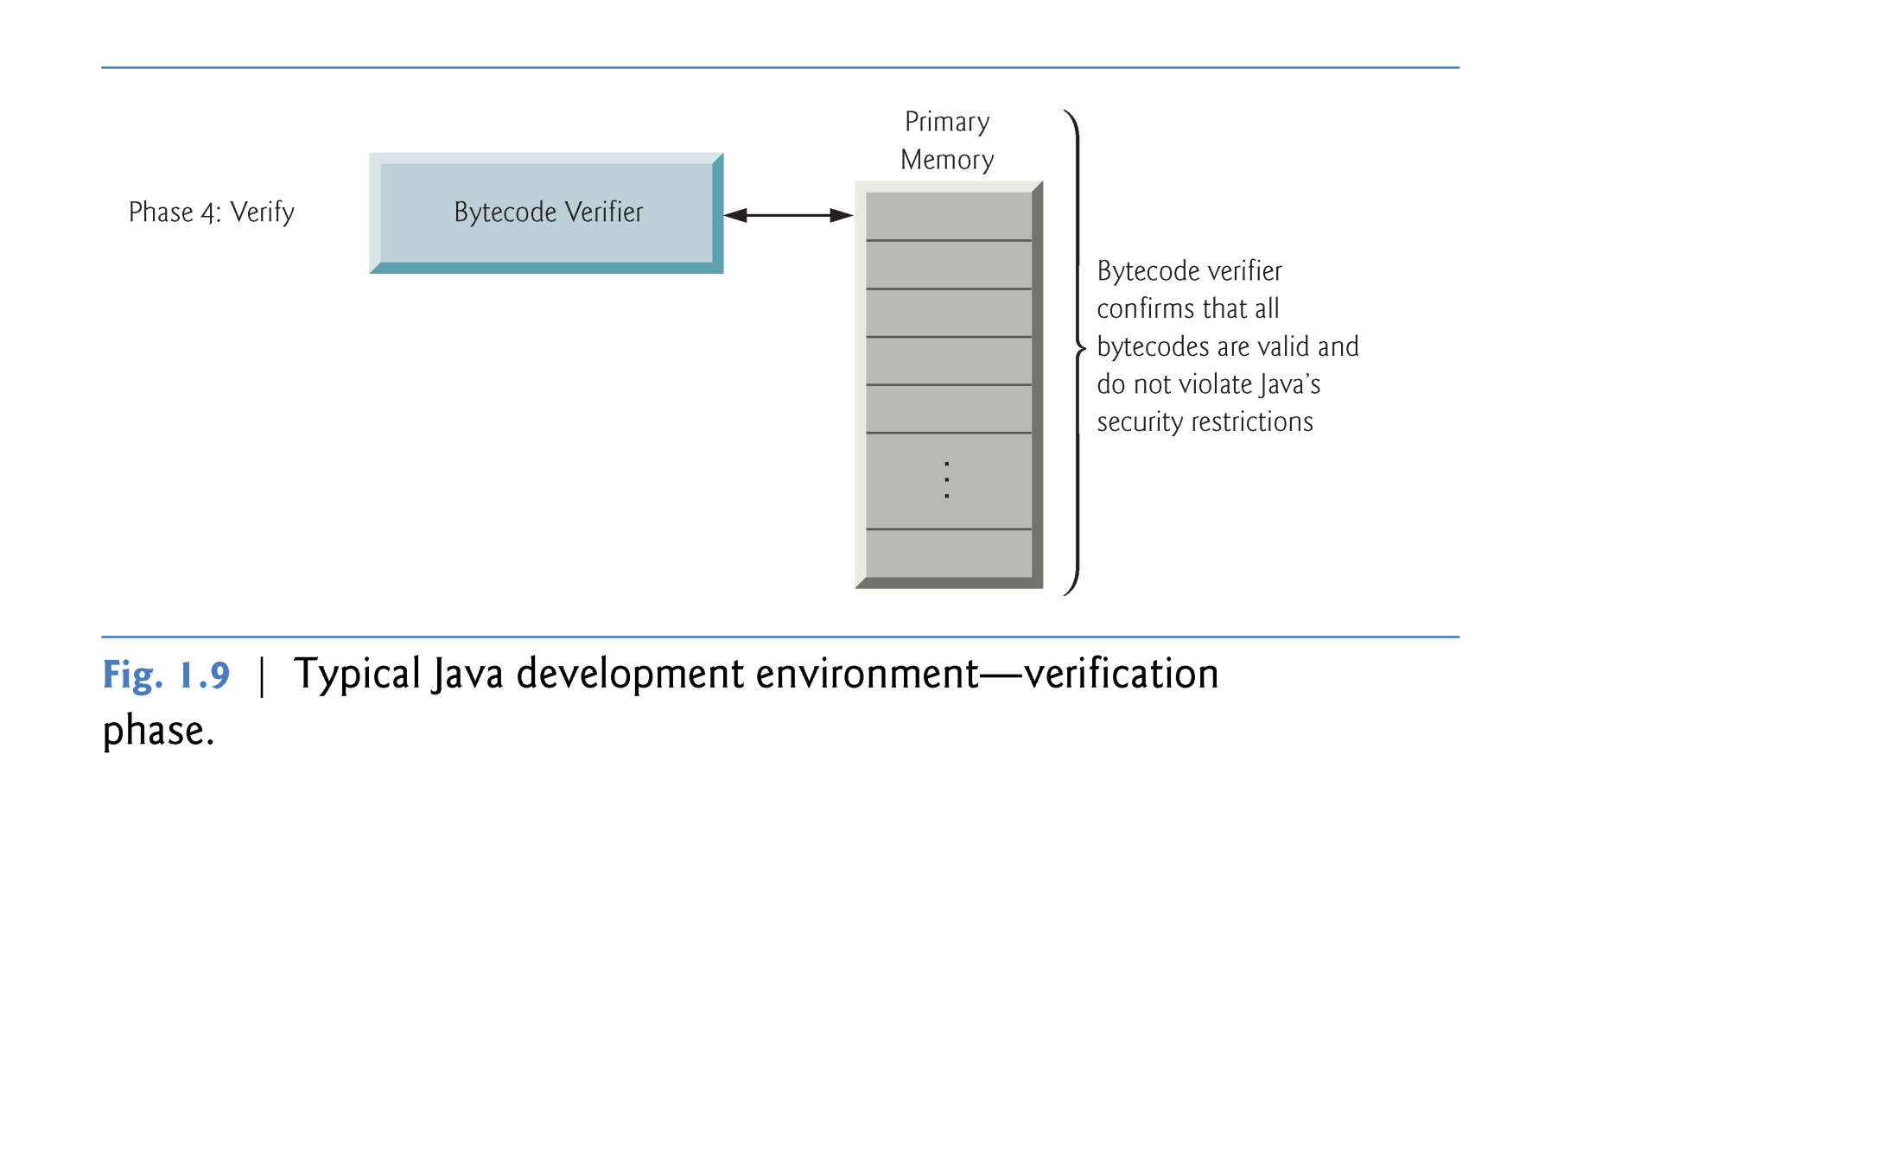
©1992-2012 by Pearson Education, Inc. All Rights Reserved.

Slide 39
Phase 5: Execution
  The JVM executes the program’s bytecodes.
  JVMs typically execute bytecodes using a combination of interpretation and so-called just-in-time (JIT) compilation.
  Analyzes the bytecodes as they’re interpreted
  A just-in-time (JIT) compiler—known as the Java HotSpot compiler—translates the bytecodes into the underlying computer’s machine language at execution time.
©1992-2012 by Pearson Education, Inc. All Rights Reserved.

Slide 40
  When the JVM encounters these compiled parts again, the faster machine-language code executes.
  In short, Java programs go through two compilation phases
    One in which source code is translated into bytecodes (for portability across JVMs on different computer platforms) and
    A second in which, during execution, the bytecodes are translated into machine language for the actual computer on which the program executes.
©1992-2012 by Pearson Education, Inc. All Rights Reserved.

Slide 41
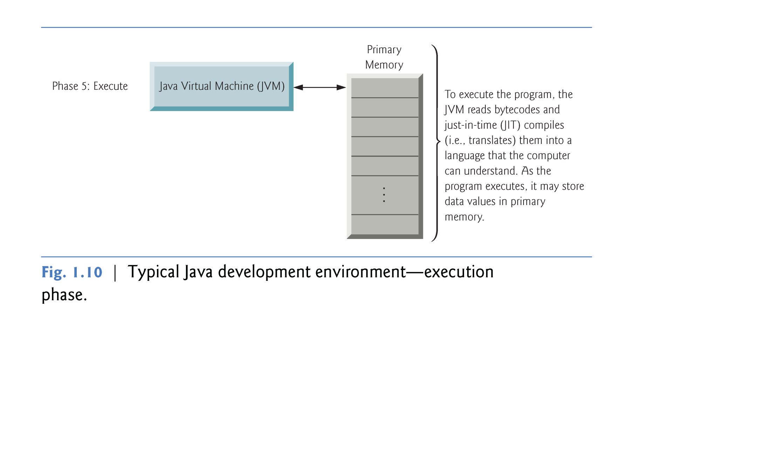
©1992-2012 by Pearson Education, Inc. All Rights Reserved.

Slide 42
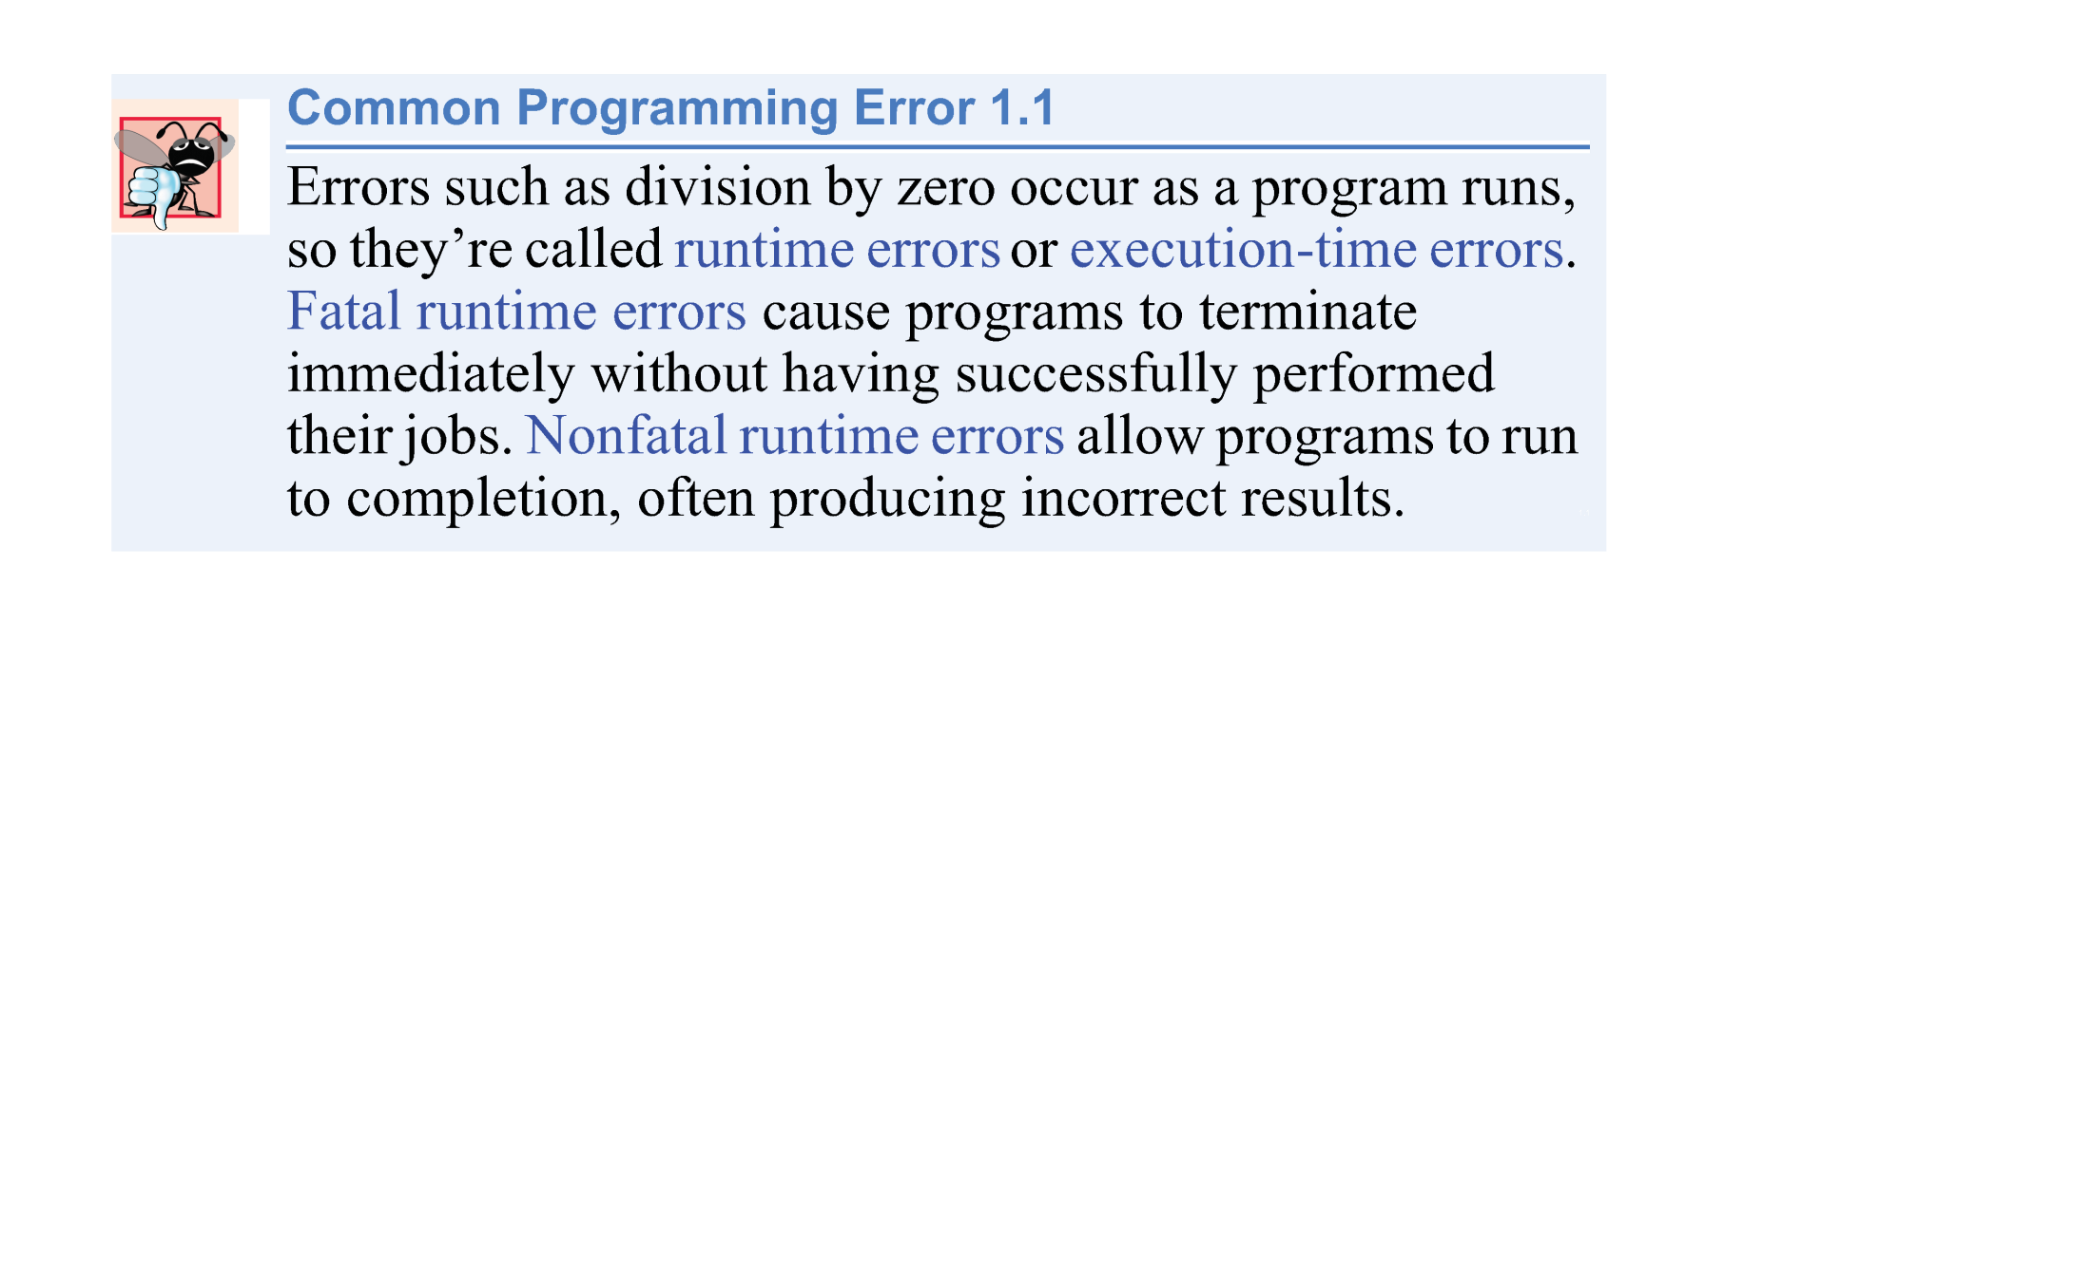
©1992-2012 by Pearson Education, Inc. All Rights Reserved.

